Slide 1
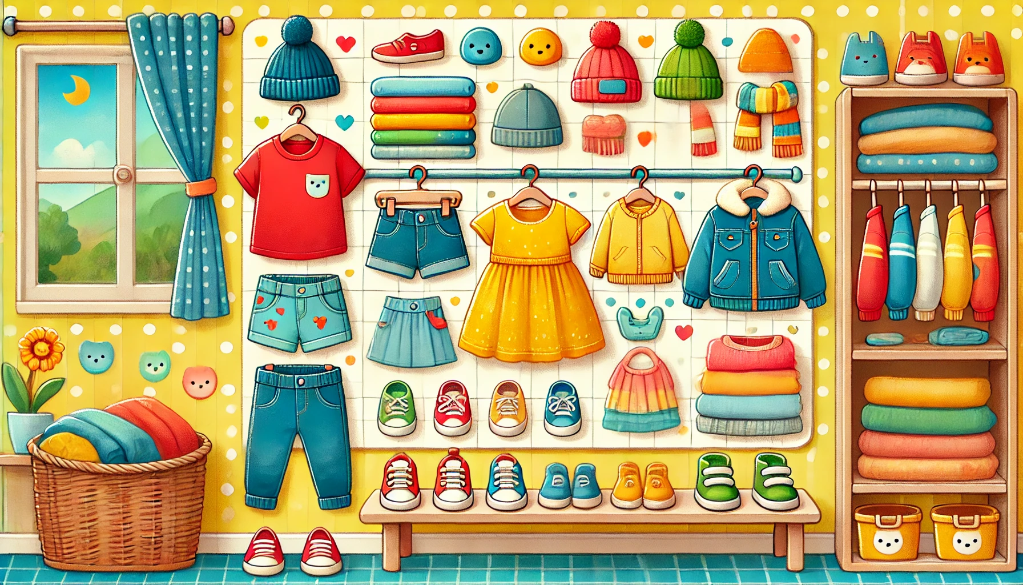
My Wardrobe
Coloring Book

Slide 2



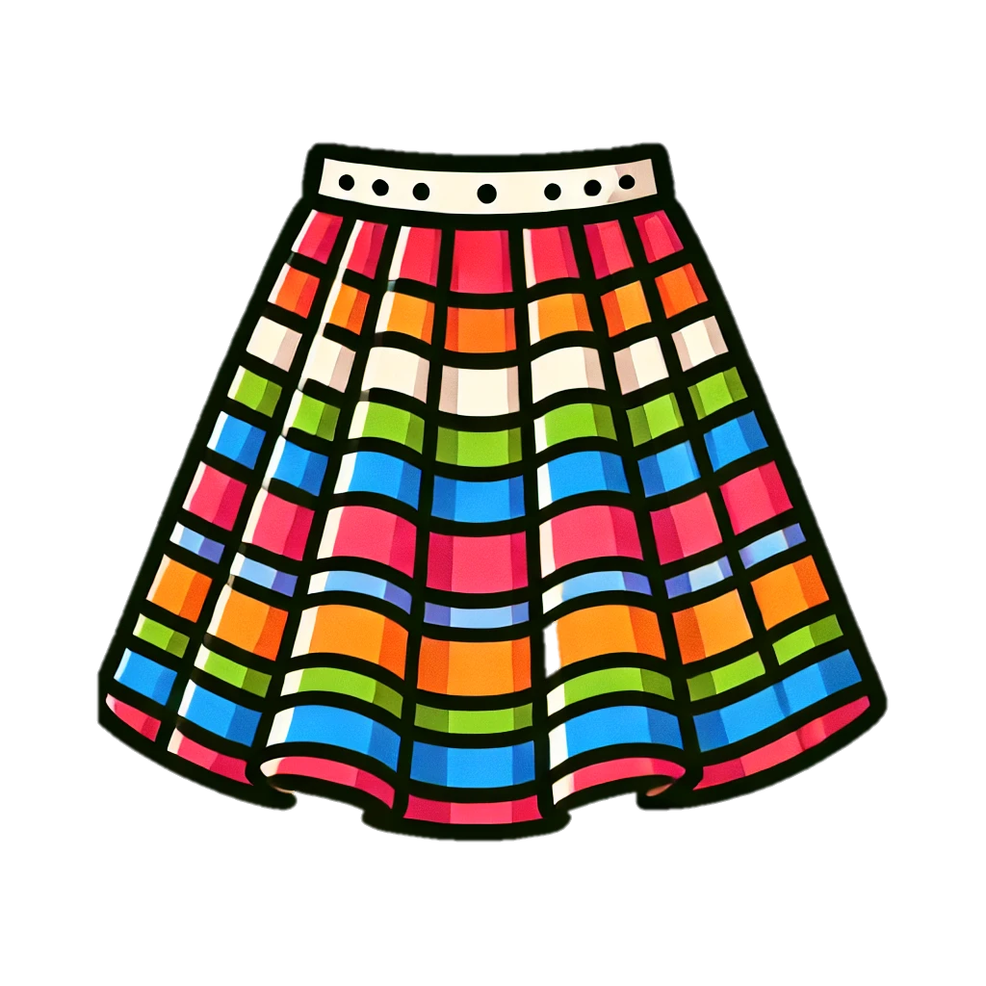
Trace & Color
My Wardrobe
Dress
Skirt

Slide 3
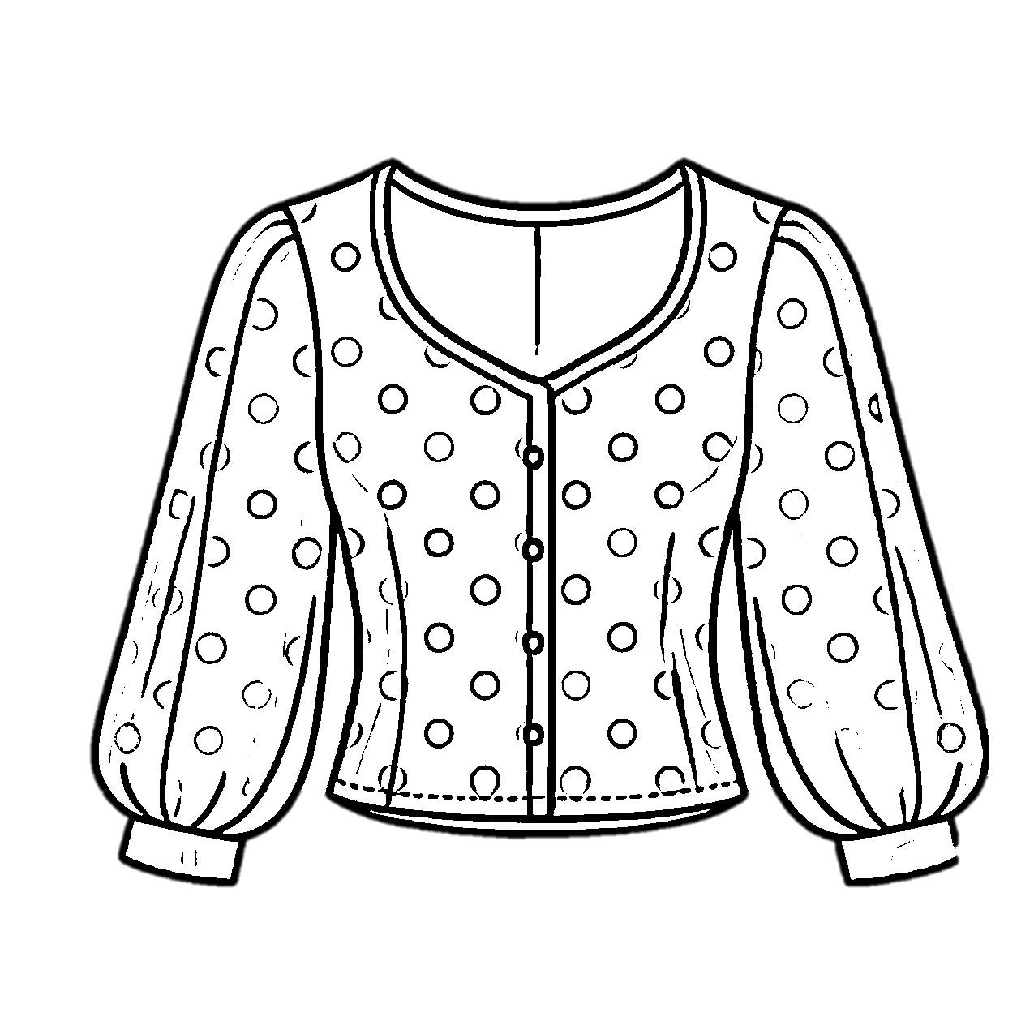
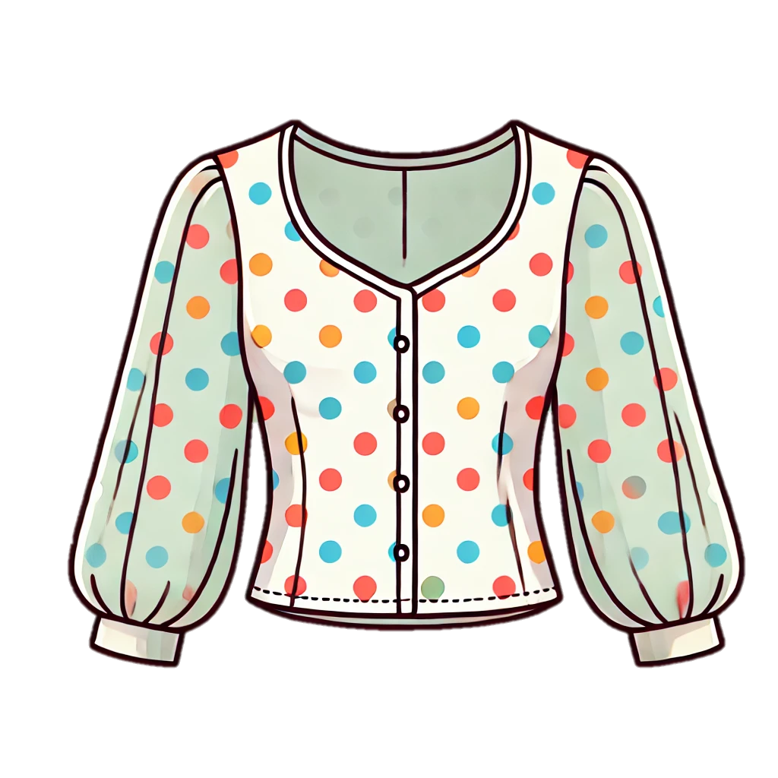


Trace & Color
My Wardrobe
Blouse
T-shirt

Slide 4


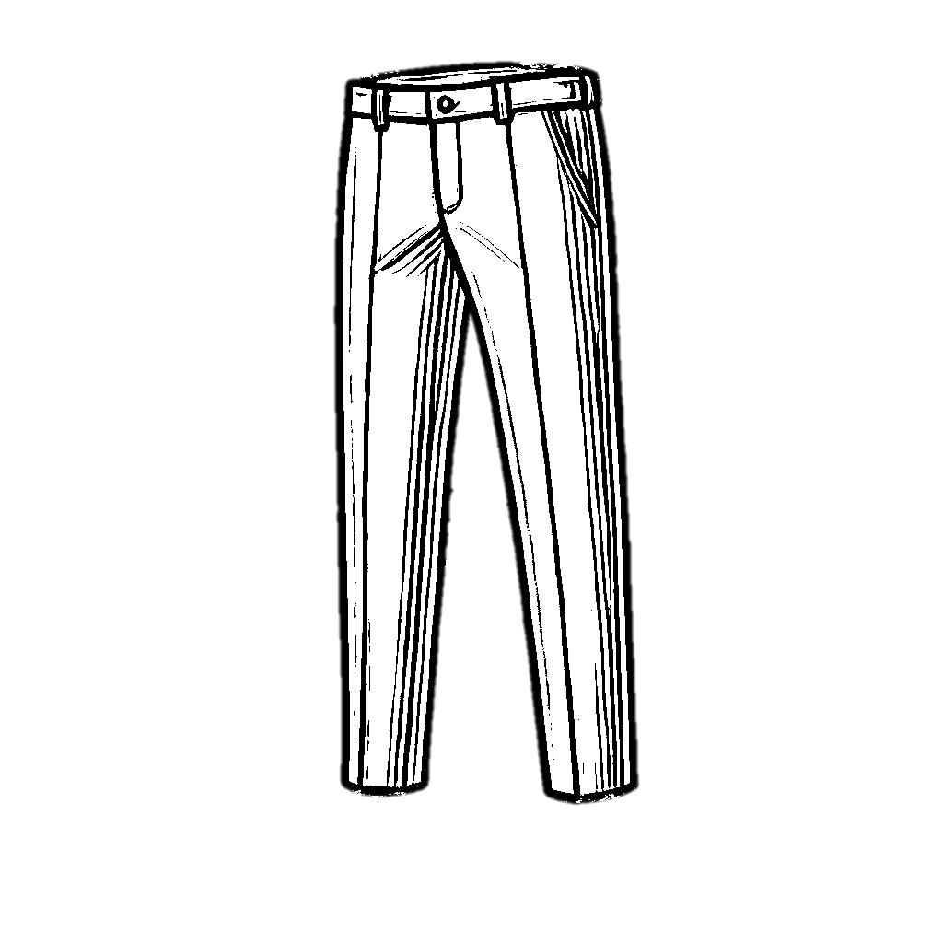
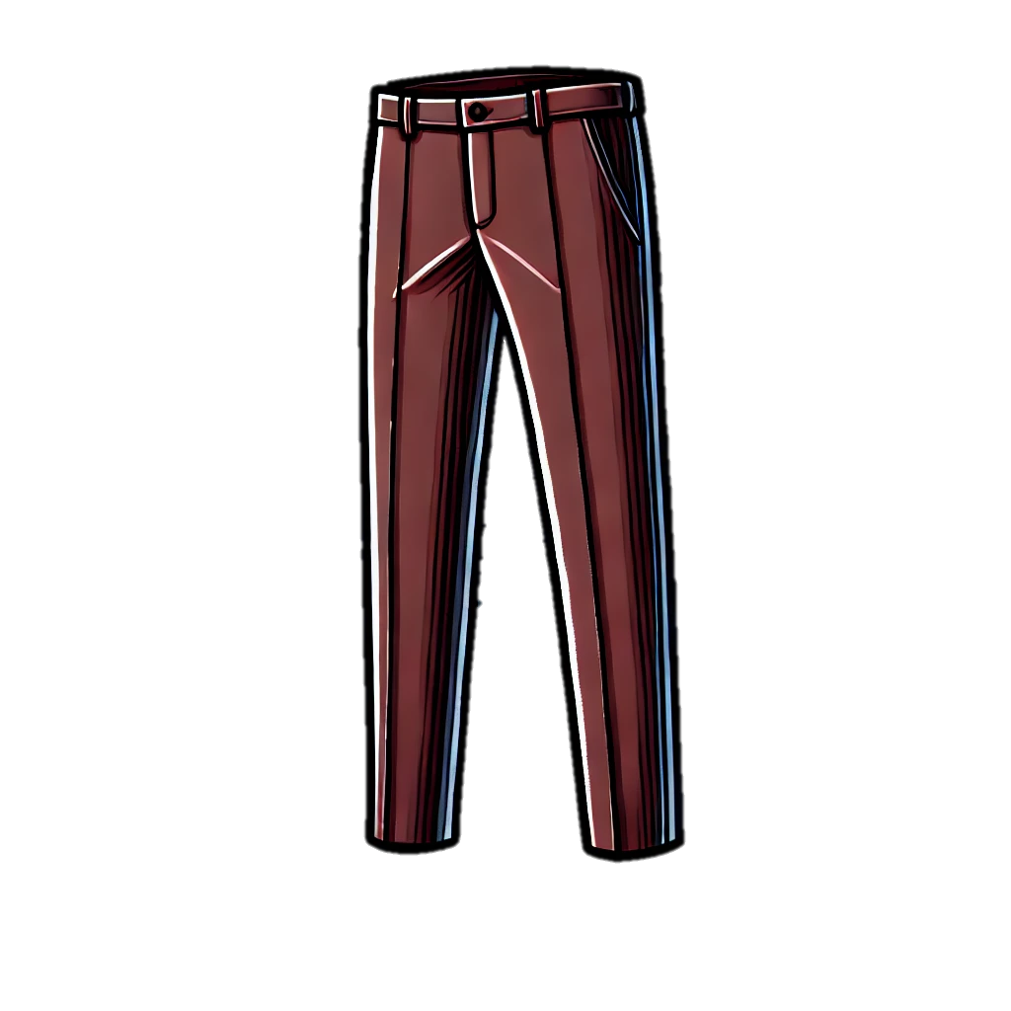
Trace & Color
My Wardrobe
Shirt
Trousers

Slide 5
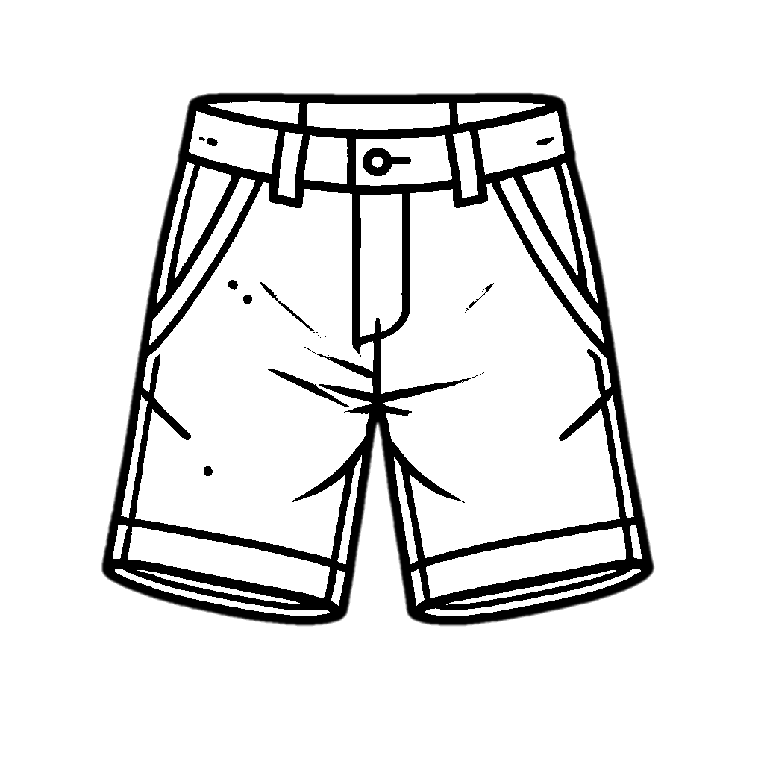

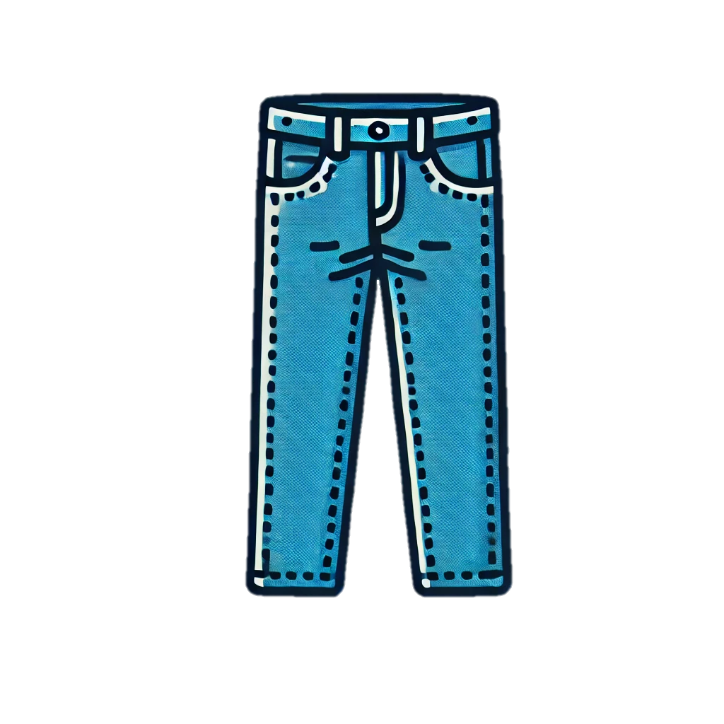

Trace & Color
My Wardrobe
Shorts
Jeans

Slide 6

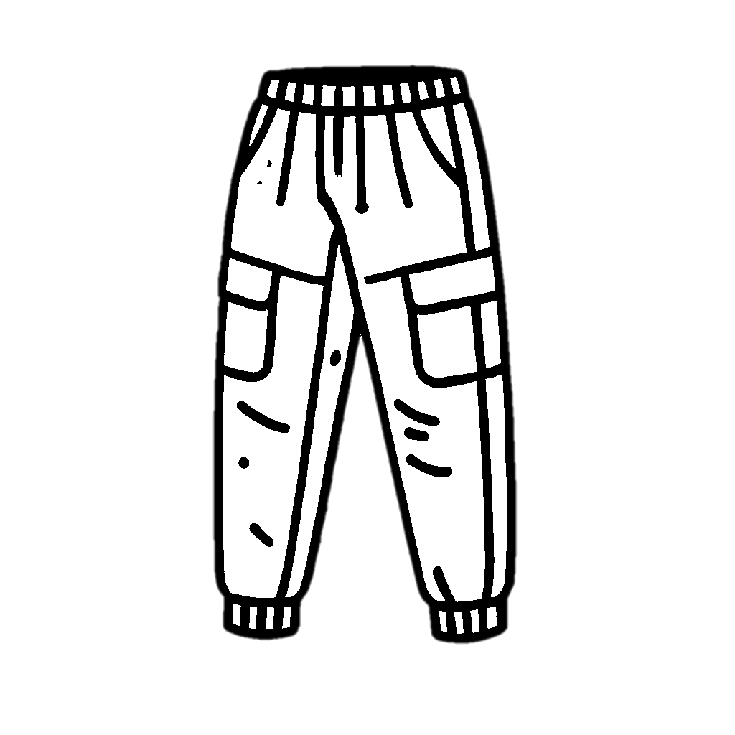
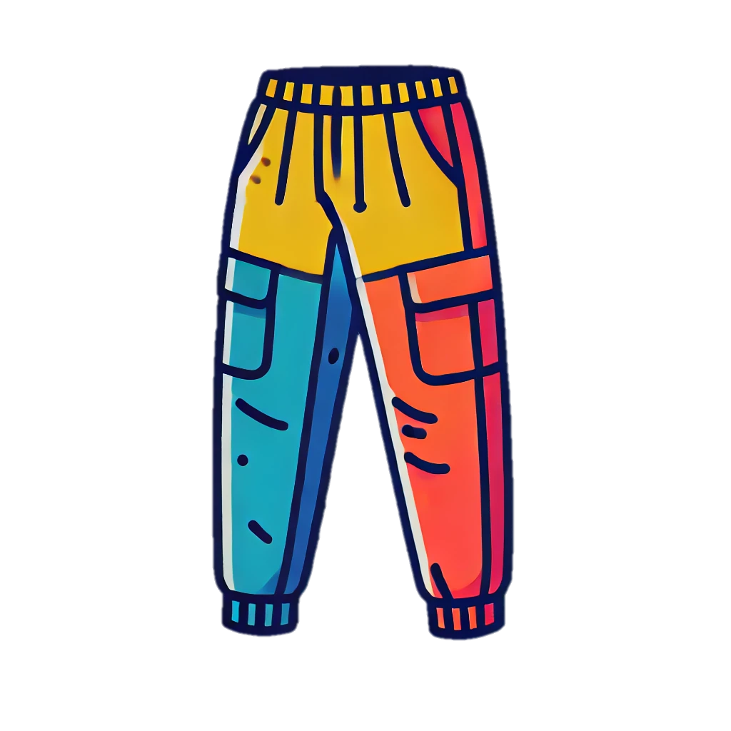
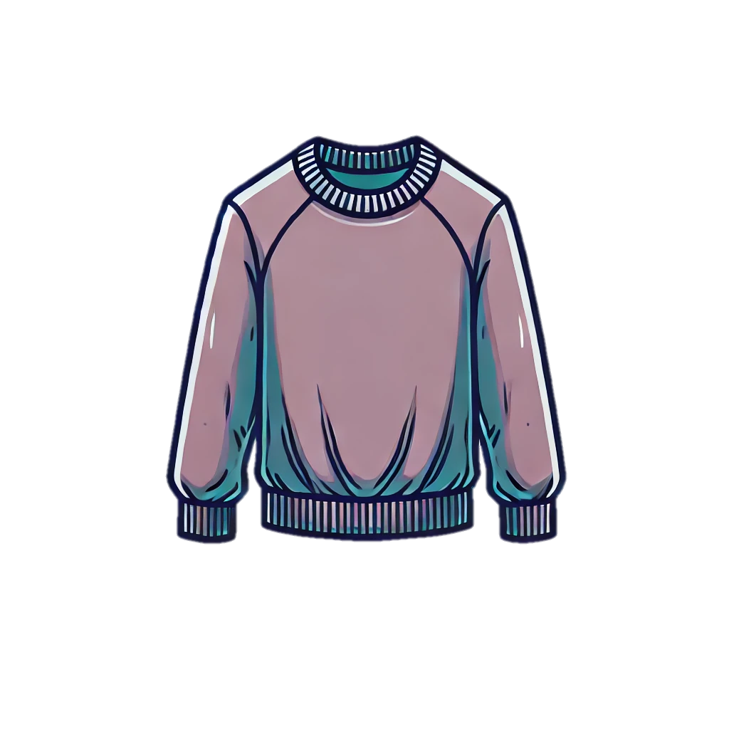
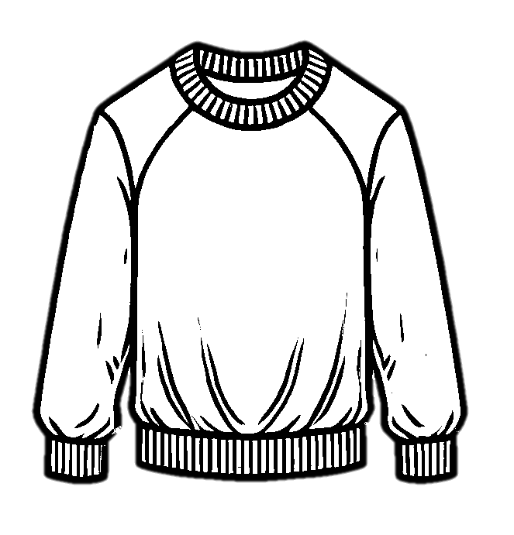
Trace & Color
My Wardrobe
Truck
Jumper

Slide 7


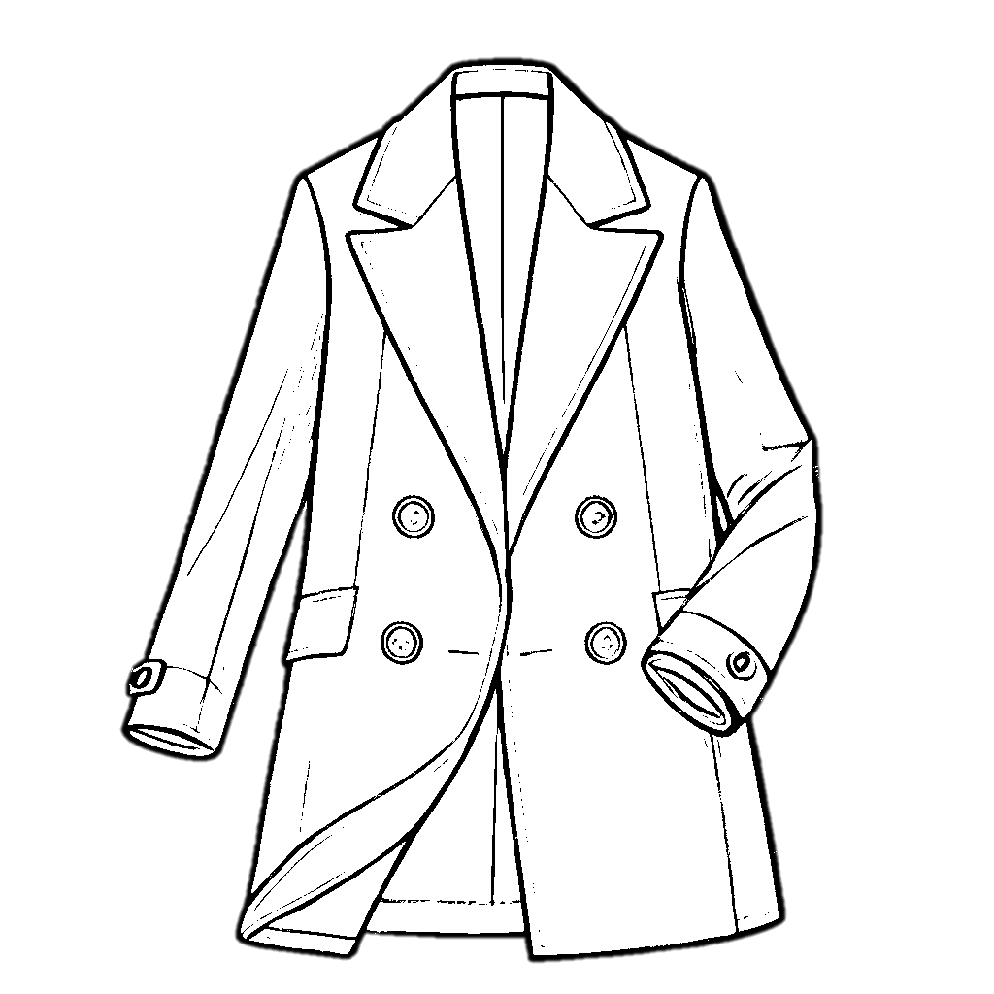
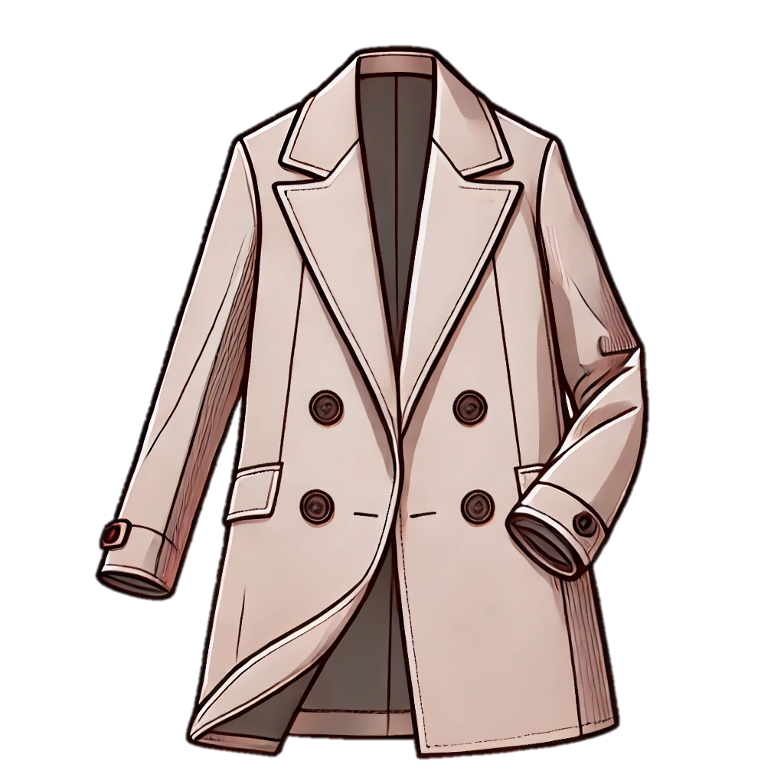
Trace & Color
My Wardrobe
Cardigan
Coat

Slide 8
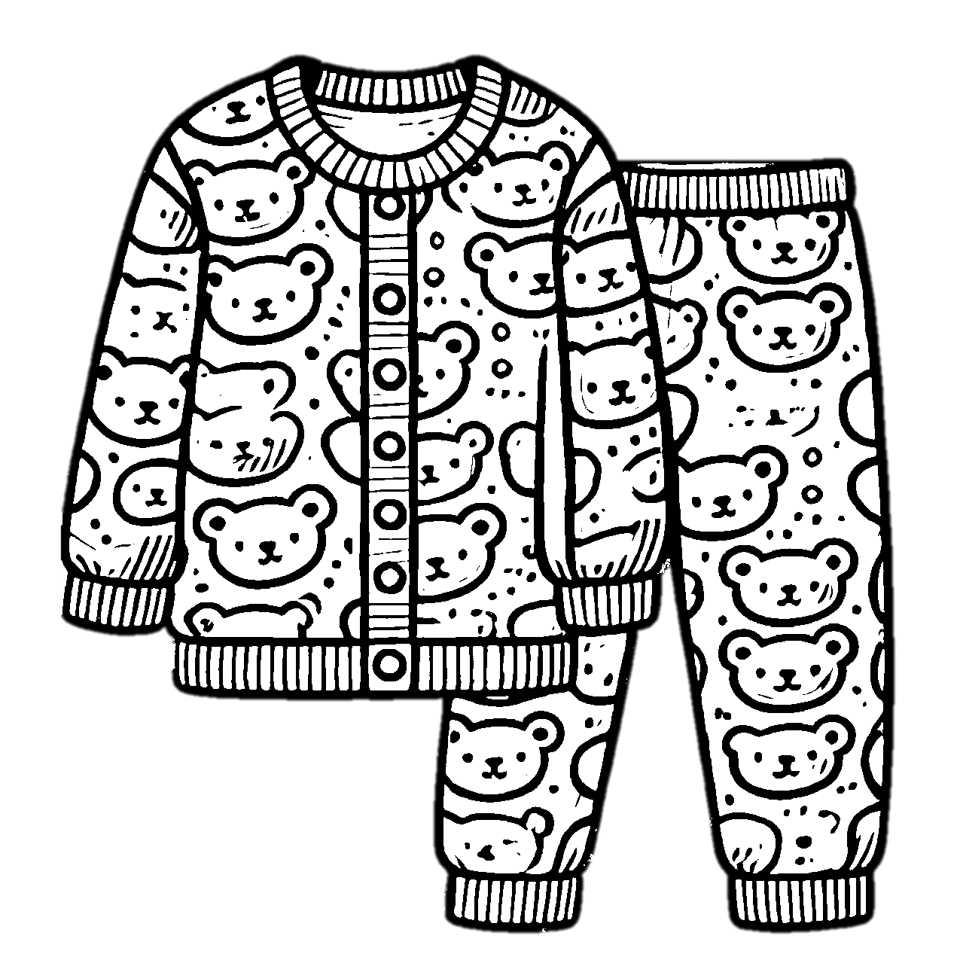
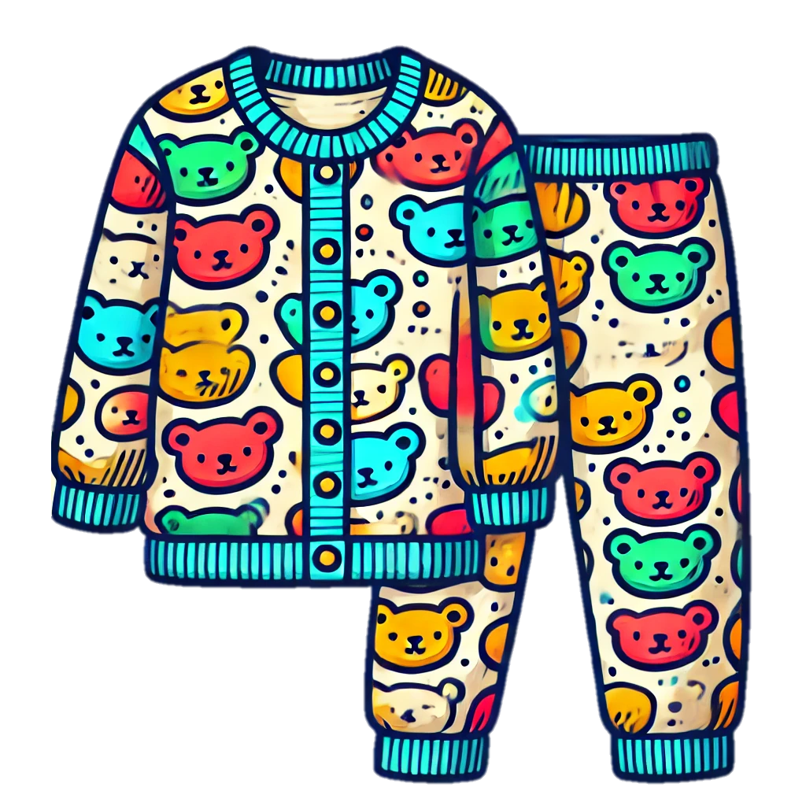


Trace & Color
My Wardrobe
Pajamas
Socks

Slide 9




Trace & Color
My Wardrobe
Vest
Pants

